Slide 1
PERMUTATIONS & COMBINATIONS
-by Bibrata Barman

Slide 2
Permutations vs. Combinations
Both are ways to count the possibilities
The difference between them is whether order matters or not ,so ordering is important.
Consider a poker hand:
  A♦, 5♥, 7♣, 10♠, K♠
Is that the same hand as:
  K♠, 10♠, 7♣, 5♥, A♦
Does the order the cards are handed out matter?
  If yes, then we are dealing with permutations
  If no, then we are dealing with combinations

Slide 3
Permutations
A permutation of a set of distinct objects is an ordered arrangement these objects.
An ordered arrangement of r elements of a set is called an r-permutation.
The number of r-permutations of a set with n elements is denoted by P(n , r).
A = {1,2,3,4} 2-permutations of A include 1,2; 2,1; 1,3; 2,3; etc…
Ordering is important.

Slide 4
Permutations
A permutation is an ordered arrangement of the elements of some set S
  Let S = {a, b, c}
  c, b, a is a permutation of S
  b, c, a is a different permutation of S
An r-permutation is an ordered arrangement of r elements of the set
  A♦, 5♥, 7♣, 10♠, K♠ is a 5-permutation of the set of cards

Slide 5
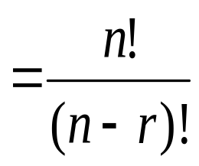
Permutations
Number of poker hands (5 cards):
  P(52,5) = 52*51*50*49*48 = 311,875,200
Number of (initial) blackjack hands (2 cards):
  P(52,2) = 52*51 = 2,652
r-permutation notation: P(n,r)
  The poker hand is one of P(52,5) permutations

Slide 6
Permutations example
How many ways are there for 5 people in this class to give presentations?
There are 27 students in the class
  P(27,5) = 27*26*25*24*23 = 9,687,600
  Note that the order they go in does matter in this example!

Slide 7
Permutation formula proof
There are n ways to choose the first element
  n-1 ways to choose the second
  n-2 ways to choose the third
  …
  n-r+1 ways to choose the r^{th} element
By the product rule, that gives us:
P(n,r) = n(n-1)(n-2)…(n-r+1)

Slide 8
Example 1
How many permutations of {a, b, c, d, e, f, g} end with a?
  Note that the set has 7 elements
The last character must be a
  The rest can be in any order
Thus, we want a 6-permutation on the set {b, c, d, e, f, g}
P(6,6) = 6! = 720

Slide 9
Example 2
In how many ways can we pick 3 elements from 5 elements ?
=>
P(n , r)=Total ways to line up r objects out of n objects.
P(5,3)=60

Slide 10
Example 3
How many 3-letter words with/without meaning can be formed from “PONDICHERRY” if repetation is not allowed ?
=>
P(11,3)=11*10*9*8 = 990

Slide 11
More Examples
In how many ways the letter of the word ‘LEADER’ be arranged ?
Find the number of permutations of the word ‘CLIMATE’ such that the vowels occur in odd places ?
In how many ways can ‘MATHEMATICS’ be arranged so total the vowels come together?

Slide 12
COMBINATION
An r-combination of elements of a set is an unordered selection of r element from the set. (i.e., an r-combination is simply a subset of the set with r elements).
Let A={1,2,3,4} 4-combinations of A are
{1,2,3}, {1,2,4}, {1,3,4}, {2,3,4}(same as {3,2,4})
The number of r-combinations of a set with n distinct elements is denoted by C(n , r).

Slide 13
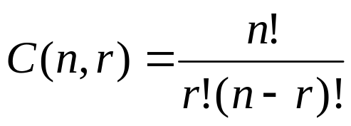
Combinations
What if order doesn’t matter?
In poker, the following two hands are equivalent:
  A♦, 5♥, 7♣, 10♠, K♠
  K♠, 10♠, 7♣, 5♥, A♦
“ ORDER IS NOT IMPORTENT ”
The number of combinations of a set with n elements, where n is non-negative and 0≤r≤n is:

Slide 14
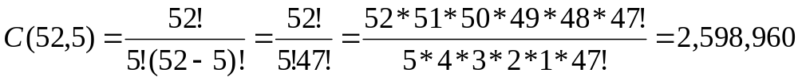
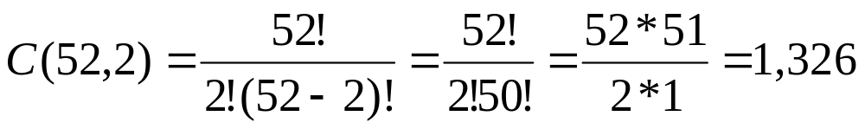
Combinations example
How many different poker hands are there (5 cards)?
How many different (initial) blackjack hands are there?

Slide 15
Combination
Given 5 people in how many ways can they take a picture without worrying about the order?
->
Here we don’t take the 3! Combinations of the each options.
P(5,3)/3! -> Number of ways to pick 3 people out of 5 people
“ORDERING” IS NOT IMPORTENT

Slide 16
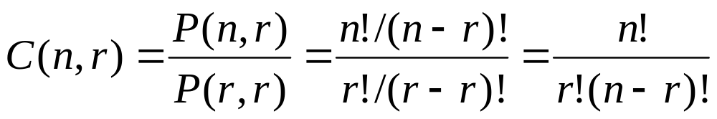
Combination formula proof
Note that the textbook explains it slightly differently, but it is same proof

Slide 17
Example
Let A = {1,2,3}
2-permutations of A are: 1,2 2,1 1,3 3,1 2,3 3,2
6 total. Order is important
2-combinations of A are: {1,2}, {1,3}, {2,3}
3 total. Order is not important
If we counted the number of permutations of each 2-combination we could figure out P(3,2)!

Slide 18
Example
How many ways are there to choose four members of the club to serve on an executive committee?
  Order not important
  C(25,4) = 25!/21!4! = 25*24*23*22/4*3*2*1 =25*23*22 = 12,650
How many ways are there to choose a president, vice president, secretary, and treasurer of the club?
  Order is important
  P(25,4) = 25!/21! = 303,600

Slide 19
Example
Find a formula for counting the number of diagonals in a n-gon?
-//we have to count the number of diagonals . n=no. of size.
C(n,2)-n //choose two vertex from the total number of vertex n
//we count only the diagonals that’s why subtract the total edges n.

Slide 20
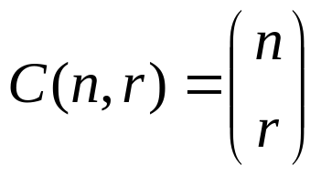
A last note on combinations
An alternative (and more common) way to denote an combination:
I’ll use C(n,r) whenever possible, as it is easier to write in PowerPoint

Slide 21
THANK YOU

